Slide 1










FORGING FORWARD:
A VIRTUAL PHILANTHROPIC CONFERENCE SERIES FOCUSED ON IDEA SHARING, INNOVATIVE SOLUTIONS, AND A PATH FORWARD
LAUNCHING
FRIDAY, MARCH 20TH
11:00AM – 12:30PM EDT
REGISTER NOW

Slide 2
OUR EXPERTS
ONE HUNDRED has brought together industry leaders across communications, marketing, corporate social responsibility, philanthropy and government relations.
OUR PRINCIPLES
True to ONE HUNDRED’s commitment to providing truly holistic and valuable counsel, this series will feature QUALIFIED, INFORMED and ACCESSIBLE content and perspectives.
OUR COMMUNITY
All conversations will be open to the public, streaming with opportunities for real-time audience engagement.
OUR TIMELINE
Forging Forward conversations will begin Friday, March 20th at 11AM EDT. The Forging Forward team will provide continuous and comprehensive content around COVID-19 every Friday at this time until further notice.
Insightful conversations with experts in communications, marketing, corporate social responsibility, philanthropy and government relations.

Slide 3



In the coming weeks, ONE HUNDRED partners and friends will host intimate and accessible web conversations addressing:
How COVID-19 is impacting philanthropy, healthcare, the global economy, and corporate social responsibility
How we can adapt to daily change, anticipate challenges, and plan for the unknown
What COVID-19 means for us now and how this pandemic will change our responsibility as global citizens and agents of change in the future

Slide 4
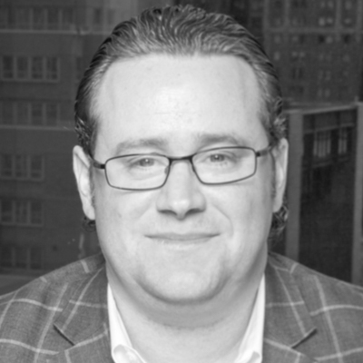
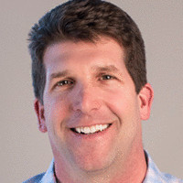
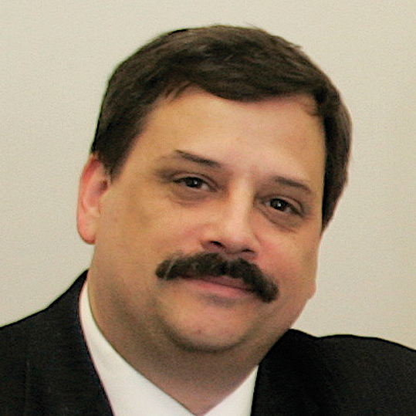
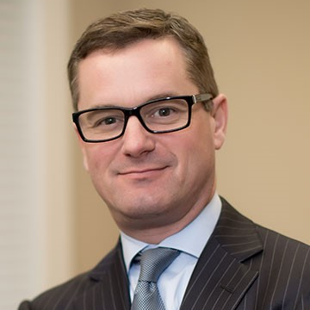
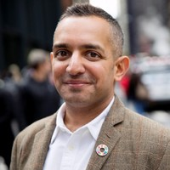
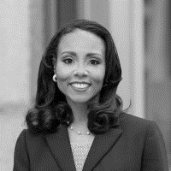
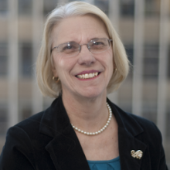
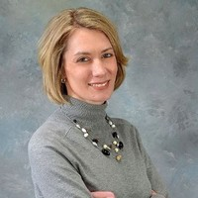
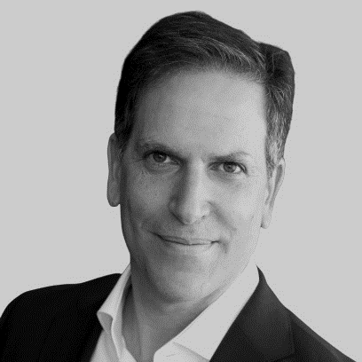
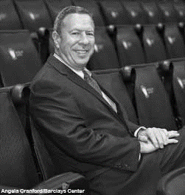
FORGING FORWARD: FEATURED EXPERTS
Brian Crimmins
Chief Executive Officer Changing Our World
Global Managing Partner
ONE HUNDRED
Jeff Morrill
Senior Director, Business Development
C Space
Paul Clolery
VP & Editorial Director
The NonProfit Times
Chad Gobel
Founder and CEO
The Gobel Group
Ravi Sunnak
EVP, Sustainable Development Goals
Porter Novelli
Tycely Williams
Chief Development Officer
America’s Promise Alliance
Dr. Susan Raymond, PhD
Senior Consultant Changing Our World
Shannon McCracken
Chief Executive
The Nonprofit Alliance
Stay tuned for presentation schedule, topics and additional experts to be announced soon!
Ben Feller
Partner
Mercury
Ed Manetta
Former D1, D2 and D3
Athletic Director

Slide 5


REGISTER NOW
JOIN US
March 20th 11:00AM – 12:30PM EDT
COVID-19: Where We Stand Today
The first web conference in the series will be a 60 minute intimate conversation between Changing Our World CEO, Brian Crimmins, Gobel Group CEO, Chad Gobel and Changing Our World Senior Consultant, Dr. Susan Raymond, PhD.
What is COVID-19’s impact on the global economy?
How does this economic tremor differ from the 2008 recession?
How do public health crises impact economic health?
How will COVID-19 impact healthcare philanthropy?

